Slide 1
Object/Image Recognition
Exploring
Convolutional Neural Network(s) (CNN)
Image Recognition
Convolutional Neural Network (CNN)

Slide 2
Convolutional Neural Network
Accomplishing CNN Image Recognition
Summary:
A Simple Neural Network (NN) and Convolutional Neural Network (CNN) will be used to accomplish Image Recognition. NN is used as benchmark comparison for the CNN (educational purposes); the analysis will be accomplished using a simple NN and compared to the CNN on the very same dataset
Technical Note: This is done as an academic exercise; this is not a one-for-one comparison, rather the process steps and final model accuracy is the focus.

Slide 3
Convolutional Neural Network
Accomplishing CNN Image Recognition
Convolutional Neural Network – Keras Sequential Model
Ref
1) https://keras.io/models/sequential/
About Keras models:
There are two main types of models available in Keras: the Sequential model, and the Model class used with the functional API. I am using the Keras Sequential API described at ref(1).
The Simple Neural Network (without convolution) is a Keras Sequential model. This is what I am comparing to the Keras Sequential CNN (with convolution).
The Sequential model is a linear stack of layers

Slide 4
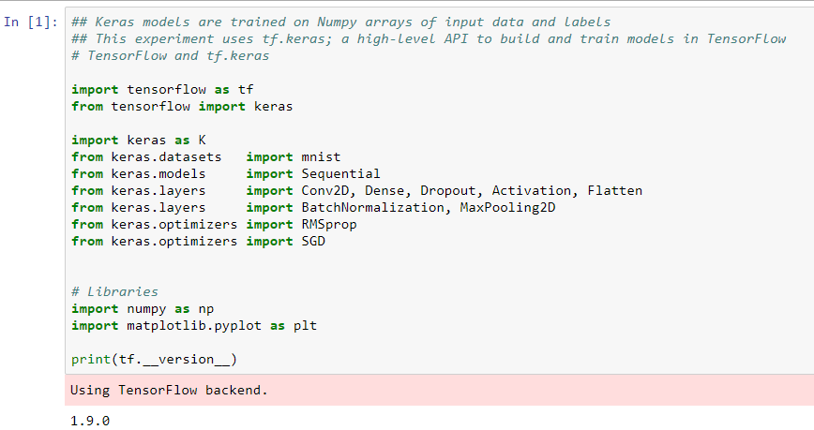
Convolutional Neural Network
Accomplishing CNN Image Recognition
Toolset setup
Keras models are trained on Numpy arrays of input data and labels
This experiment uses tf.keras; a high-level API to build and train models in TensorFlow

Slide 5
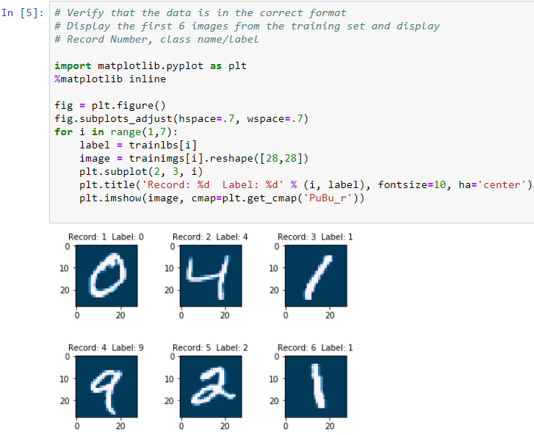
Convolutional Neural Network
Accomplishing CNN Image Recognition
Dataset review
The data has previously been cleaned and verified; this step again verifies that the imprted dataset is the correct datset and is not corrupted.
The (2,3) plot is a selection of the first six Training set records. The check is to compare the Label to the Image.

Slide 6
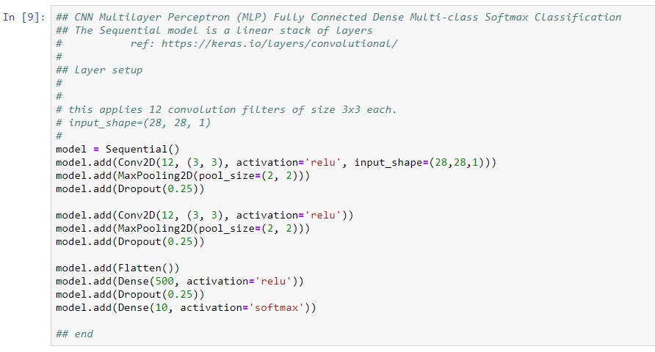
Convolutional Neural Network
Accomplishing CNN Image Recognition
Layer Setup – Building the Model
Build the Model
First
Building the Model requires Configuring the Layers first
Second
Build model
Compile model
Train[fit] model

Slide 7
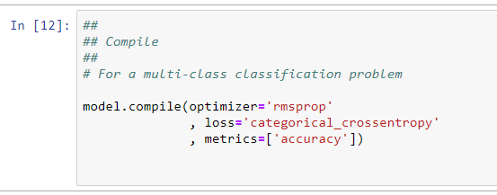
Convolutional Neural Network
Accomplishing CNN Image Recognition
Compile the model
Ref:
1) https://keras.io/getting-started/sequential-model-guide/
Loss function — This measures how accurate the model is during training. We want to minimize this function to "steer" the model in the right direction.
Optimizer — This is how the model is updated based on the data it sees and its loss function.
Metrics — Used to monitor the training and testing steps. The following example uses accuracy, the fraction of the images that are correctly classified.
Compile

Slide 8
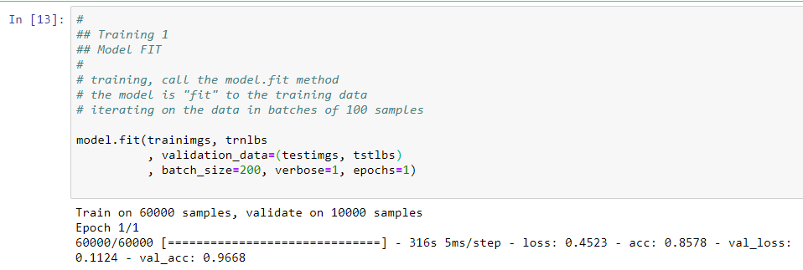
Convolutional Neural Network
Accomplishing CNN Image Recognition
Train the model
ref: https://keras.io/getting-started/sequential-model-guide/
Keras models are trained on Numpy arrays of input data and labels.
Training the neural network model requires the following steps:
Feed the training data to the model — in this experiment arrays train_images and train_labels
The model learns to associate images and labels.
Ask the model to make predictions about a test set
Verify that the predictions match the labels *** the test_labels array
Technical Note: One epoch consists of one full training cycle on the training set. Once every sample in the set is seen, you start again - marking the beginning of the 2nd epoch.
Technical Note: This experiment finishes at the Accuracy Check.
Training – CNN Model fit with one(1) epoch

Slide 9
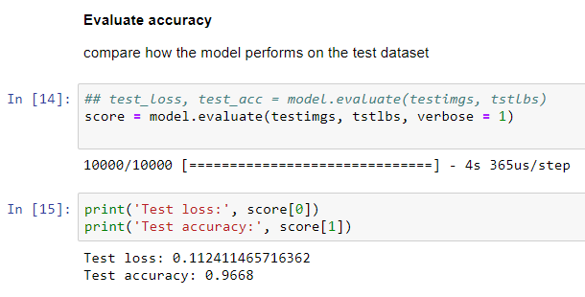
Convolutional Neural Network
Accomplishing CNN Image Recognition
Evaluate Accuracy
Compare how the model performs on the test dataset
CNN Accuracy: 97%
This is considered acceptable, most Accuracy checks that are greater than 95% is considered good.

